Slide 1
Design Feedback March 20th 2016
®
Prepared for LG

Slide 2
Summary
NextInput makes the following recommendations:
Move sensors as far away from the bond area as possible
Minimize bond area in the upper/lower regions of the phone
Avoid “Bottoming Out” of Display and Glass on any other component
Prepared for LG

Slide 3
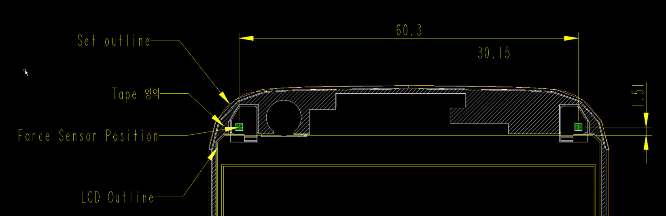
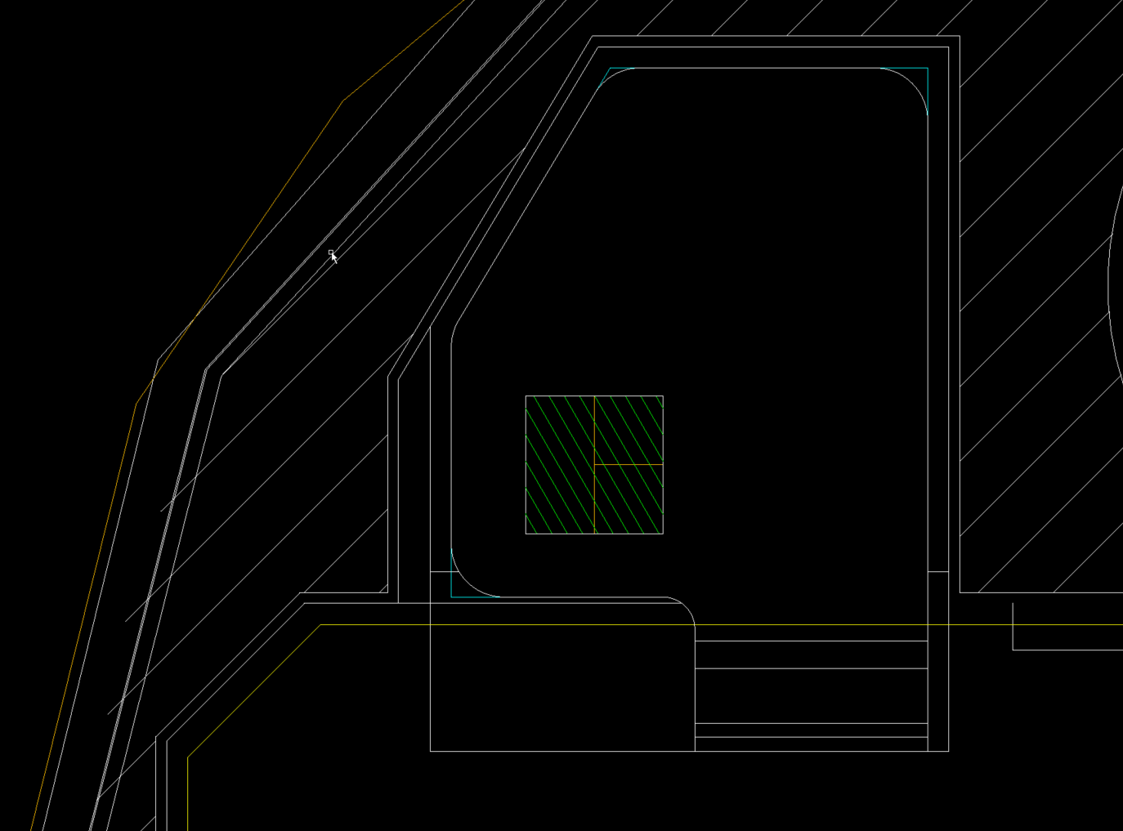
Move Sensors Far Away From Bond
Prepared for LG
Area of Detail
Before
After

Slide 4
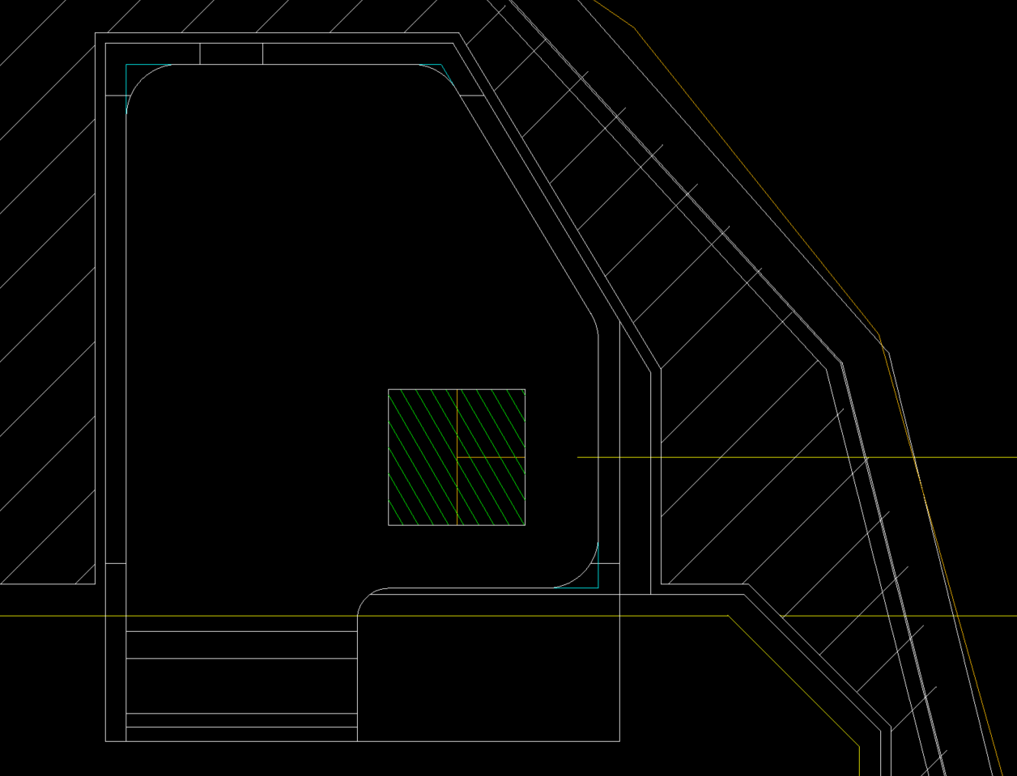
Move Sensors Far Away From Bond
Prepared for LG
Area of Detail
Before
After

Slide 5
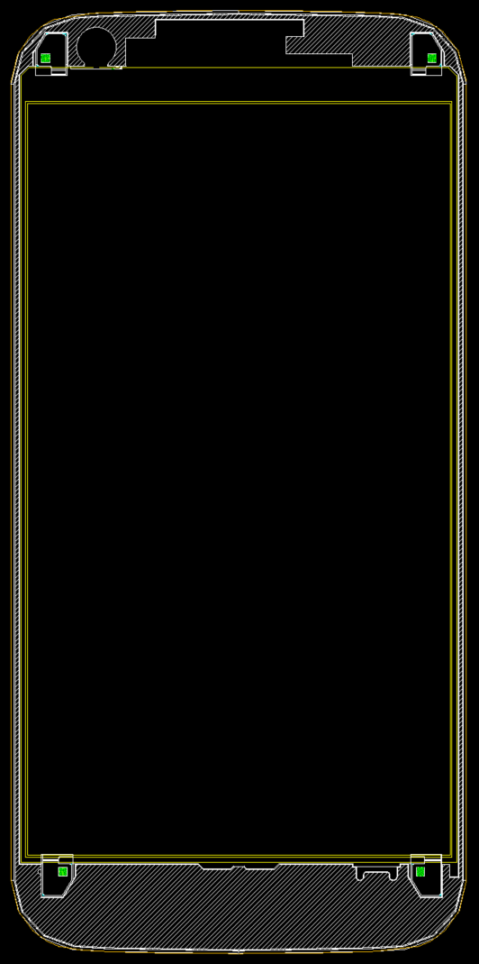
Minimize Bond Area
Prepared for LG
Remove this bond area and the plastic material underneath it to minimize shunt forces and ensure glass does not “bottom out” on plastic

Slide 6
Avoid “Bottoming Out” Display
Min Gap must be engineered so that at F_{TouchMax} in the center of the glass, display does not touch any other part:
Prepared for LG
F_{TouchMax}
Display
“Bottomed Out”
`
Edge
Bond
Sensor
Sensor
Edge
Bond
Sensor
Mid-Frame, PCB, etc.
Battery
Note: Cross Section Not to Scale. Deformation is exaggerated for clarity.
Other components omitted for clarity.

Slide 7
Avoid “Bottoming Out” Glass
Cross Section A-A:
Prepared for LG
F_{TouchMax}
Glass May
“Bottom Out”
S
S
Sensor
Mid-Frame, PCB, etc.
Battery
Glass May
“Bottom Out”
Note: Cross Section Not to Scale. Deformation is exaggerated for clarity.
Other components omitted for clarity.
A
A

